Slide 1
Stream Processing in Modern Enterprise
Presenter: Peter Nicaj

Slide 2
Outline
Big data processing
First developed structures
Stream Processing
Platform and modern use cases
Conclusion

Slide 3




What needs to be processed?
Business or User transactions
Stocks
User clicks (Twitter and Facebook)
Business reports
Fraud Detection

Slide 4
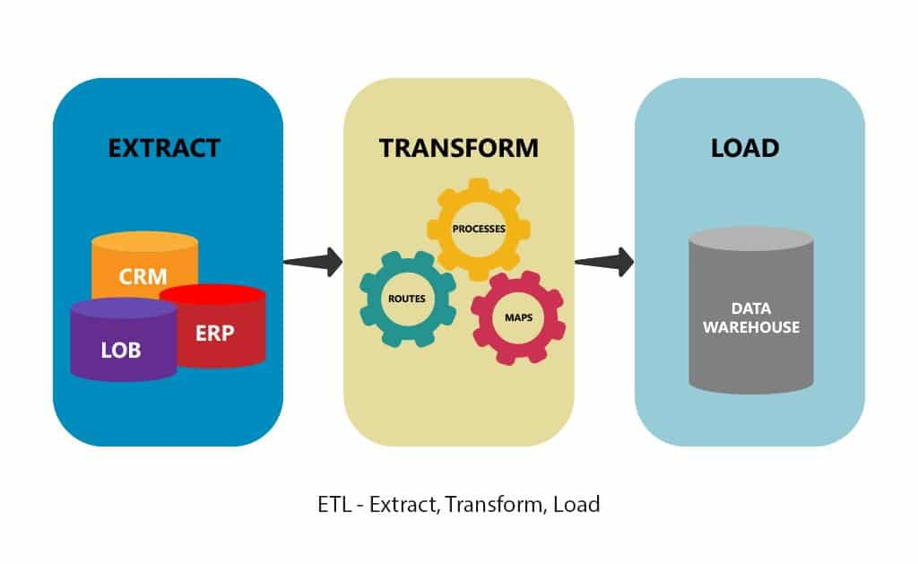

How is big data processed?
Pull the information
Process the information
Store the processed data

Slide 5

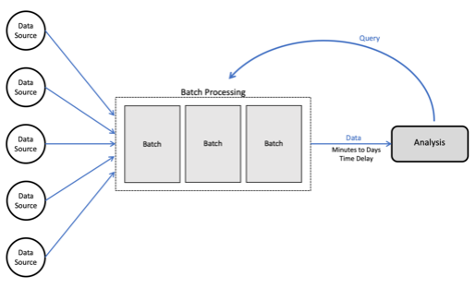



Process history data
Example is using SQL statement to process
Process periodically

Slide 6
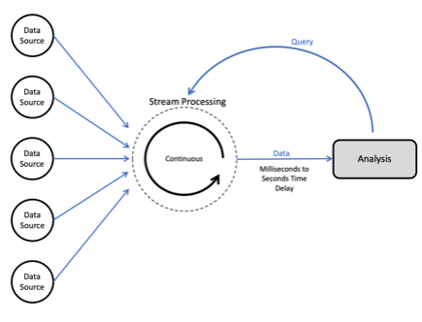
ETL Structure for Real time entries
Dynamic data set
Constant change to raw data
Process in milliseconds to seconds

Slide 7


What is Kafka?
Created in 2011 by LinkedIn Engineers
Common open source stream processing software
Written in Scala and Java

Slide 8
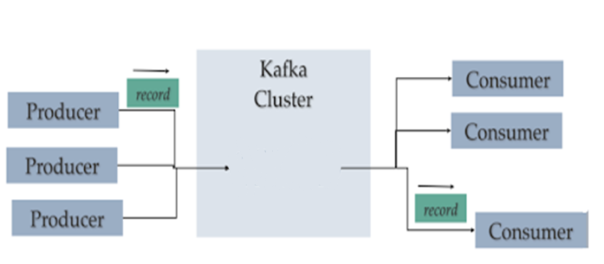
Kafka Platform
Producer Data – Data that is sent to the broker
Consumer Data – Data that is stored on a broker ready to be consumed

Slide 9
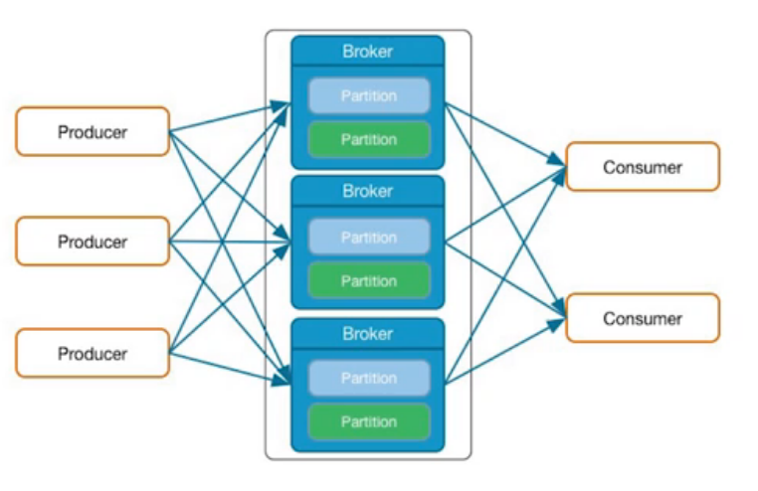
Kafka Terms
Message or Record – A single entry of data
Topic – Messages are stored here
Partitions – topics are split up
Brokers - Servers where all partitions are stored

Slide 10

Java Kafka Producer Application
Step 1 – Produce the record
Step 2 – Create producer object for records
Step 3 – Send the producer data to the Kafka cluster

Slide 11

Java Kafka Consumer Application
Step 1 – Create consumer object
Step 2 – Subscribe to the topic that you want to receive from Kafka cluster
Step 3 – Create a record object for consumer records to fetch messages

Slide 12
Wikipedia edits Demo
Confluent demo that uses Kafka
Monitor real-time edits to real Wikipedia pages

Slide 13
Beneficial Use Cases
Fraud Detection
Constant interaction with application
Banking Systems
Stocks
System Log

Slide 14
Conclusion
ETL was the first big data processing structure
Batch processes history data periodically
Businesses needed data faster
Stream processing is fast for modern enterprise

